Slide 1
Parallelization of Image Processing Algorithms
CSCI465: Parallel Computing Project

Slide 2
Team Members
AbdelRahman Rahal 221001443
Mahmoud AbdelGelil 221001313
Mostafa Gamal Amer 221001207
Nour Elsharkawy 221001458
Youssef Zakaria Mansour 202001954

Slide 3
01
Problem
The main idea of our project

Slide 4
Image Processing Algorithms
An Existing Codebase
As we were tasked, we took upon improving a previous project of ours that showcased image processing algorithms. It used purely serial code and was perfect to test the auto-parallelization concept.
Great Performance Differences
Serial image processing algorithms are notoriously slow and would really showcase the benefits of parallelization.
A Relevant Problem
The speeding up of image processing algorithms is a sought-after improvement in nowadays digital ecosystem.

Slide 5
02
Methodology
What we used to achieve our speed-up

Slide 6
Python's Numba
An open-source just-in-time (JIT) compiler that translates a subset of Python and NumPy code into fast machine code (via LLVM).
Since our original codebase is written in Python, it was the best and most obvious choice.
It works in a similar fashion to C's OpenMP, and has similar features such as "prange" ("parallel for" in OpenMP).
It's perfect for auto-parallelization as we don't need to change the serial code at all, but to add:
jit(parallel=True) decorator to the functions we want parallelized
pranges to the loops we wanted parallelized instead of normal ranges

Slide 7
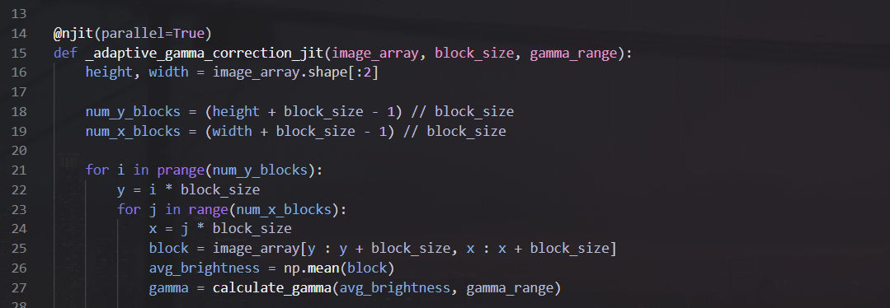
Python's Numba

Slide 8
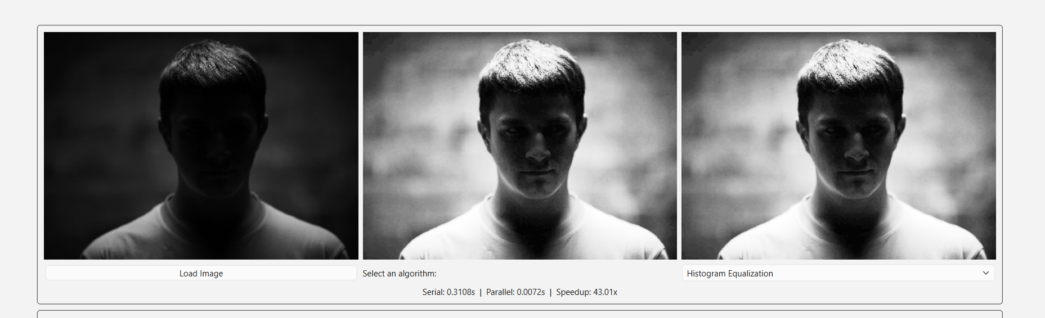
GUI Modification
The original application came with a GUI to showcase these algorithms.
We hijacked that GUI to show the differences and speed-up between both serial and parallel implementation of the same algorithm.

Slide 9
03
Results
What we used to achieve our speed-up

Slide 10
Perf Results
We used perf tool to test the serial and parallel implementation of the gaussian blur algorithm on 10 very large (4000 x 4000) images.
Metric | Serial | Parallel | Improvement
Total time (10 runs) | 1374.0 s | 3.20 s | 429× faster
Average time per run | 137.4 s | 0.32 s | 429× faster
CPU utilization | 1.0 CPUs | 6.2 CPUs | 6.2× more cores used
User time | 1367.2 s | 31.35 s | 44× less CPU time
System time | 0.96 s | 3.07 s | slightly higher (thread overhead)
Elapsed (wall) time | 1374.2 s | 5.65 s | 243× faster

Slide 11
Perf Results: Summary
Speedup
429× (137 seconds → 0.32 seconds per 4000 x 4000 image)
Efficiency
Parallel version retires 64% of cycles vs. 40% in serial due to far less frontend stalling.
Cost
Slight increase in branch misses, page faults, and system time, but dwarfed by the massive speedup.

Slide 12
Thank you for listening!
Any Questions?

